Slide 1
Neural Net Report
Your Name: Lucas Luwa
Your GT Username: lluwa3

Slide 2
Question 5: Learning With Restarts
testPenData:
Max accuracy: 0.9102344196683819
Average accuracy: 0.8999428244711263
Standard deviation: 0.008338615247097609
testCarData:
Max accuracy: 0.995
Average accuracy: 0.985
Standard deviation: 0.008944271909999166

Slide 3
Question 6: Varying the Hidden Layers
Statistic table for testPenData – report the max, average, and standard deviation at various amount of perceptrons.
 | Number of Perceptrons at the Hidden Layer
 | 0 | 5 | 10 | 15 | 20 | 25 | 30 | 35 | 40
Max Accuracy | 0.0 | 0.8525 | 0.8991 | 0.9097 | 0.9091 | 0.9097 | 0.9054 | 0.9045 | 0.9039
Avg Accuracy | 0.0 | 0.8440 | 0.8915 | 0.9017 | 0.9071 | 0.9058 | 0.9002 | 0.9034 | 0.9003
Standard Deviation | 0.0 | 0.0065 | 0.0060 | 0.0065 | 0.0013 | 0.0027 | 0.0074 | 0.0008 | 0.0022

Slide 4
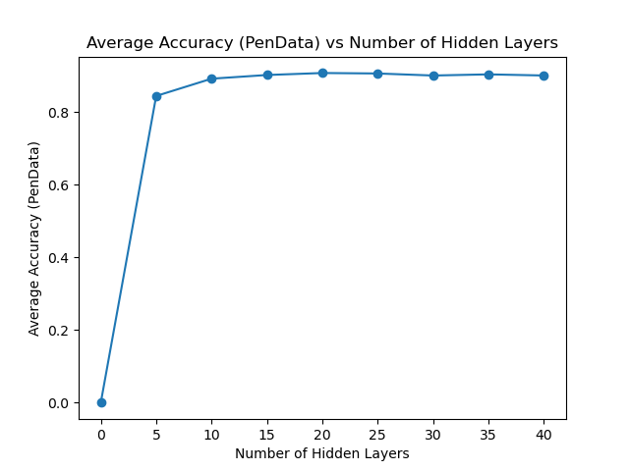
Question 6: Varying the Hidden Layers
Create a learning curve for testPenData where the number of hidden layer perceptrons is the independent variable and the average accuracy is the dependent variable.
[attach your image/graph here]

Slide 5
Question 6: Varying the Hidden Layers
For testPenData, discuss any notable trends you saw related to increasing the size of the hidden layers in your neural net.
Answer: There is a very noticeable jump in accuracy from 0 to 5 hidden layers. However, after this, the accuracy increases slightly before plateauing out at around 90%. It seems that the optimal number of hidden layers is between 10 and 15 layers since additional layers after this don’t really benefit the model and really only adds extra complexity to something that could be accomplished with fewer layers. Overall, accuracy is affected by the number of hidden layers, but adding more layers after a certain point doesn’t necessary help us improve accuracy further.

Slide 6
Question 6: Varying the Hidden Layers
Statistic table for testCarData – report the max, average, and standard deviation at various amount of perceptrons.
 | Number of Perceptrons at the Hidden Layer
 | 0 | 5 | 10 | 15 | 20 | 25 | 30 | 35 | 40
Max Accuracy | 0.71 | 0.97 | 0.99 | 0.99 | 0.98 | 0.985 | 0.99 | 0.99 | 0.99
Avg Accuracy | 0.71 | 0.967 | 0.985 | 0.985 | 0.976 | 0.978 | 0.987 | 0.98 | 0.974
Standard Deviation | 0.0 | 0.0024 | 0.0032 | 0.0077 | 0.0037 | 0.0051 | 0.0024 | 0.0071 | 0.0097

Slide 7
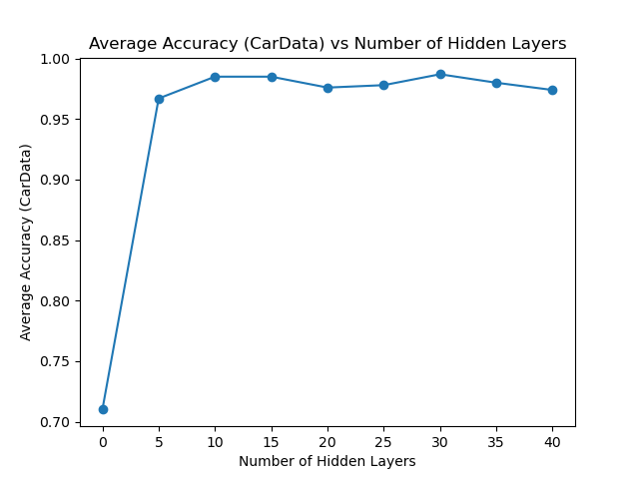
Question 6: Varying the Hidden Layers
Create a learning curve for testCarData where the number of hidden layer perceptrons is the independent variable and the average accuracy is the dependent variable.
[attach your image/graph here]

Slide 8
Question 6: Varying the Hidden Layers
For testCarData, discuss any notable trends you saw related to increasing the size of the hidden layers in your neural net.
Answer: Just like the previous graph, there is a very noticeable jump in accuracy from 0 to 5 hidden layers. After this initial spike, the accuracy increases slightly before plateauing out in the range of 96-99%. It seems that the optimal number of hidden layers is around 10 layers since adding more layers after this don’t really benefit the model and really only adds extra complexity to something that could be accomplished with fewer layers. Overall, accuracy is affected by the number of hidden layers, but adding more layers after a certain point doesn’t necessary help us improve accuracy further, which is similar to the situation in the previous testPenData model.

Slide 9
Question 7 (extra credit): Learning XOR
Report the max accuracy, average accuracy, and standard deviation of the neural net that you have trained with 1) no hidden layer, and 2) a hidden layer with various amount of perceptrons (at least 3 different amounts)
 | No Hidden Layer | Hidden Layer
 |  | 15 perceptrons | 35 perceptrons | 45 perceptrons
Max Accuracy | 0.5 | 0.75 | 1.0 | 1.0
Avg Accuracy | 0.3 | 0.5 | 0.8 | 0.95
Standard Deviation | 0.24494897427831 | 0.2738612787525 | 0.187082869338 | 0.1

Slide 10
Question 7 (extra credit): Learning XOR
Report the behavior of the trained neural net without a hidden layer.
Answer:

Slide 11
Question 7 (extra credit): Learning XOR
Report the behavior of the trained neural net with a hidden layer. Are the results what you expected? Explain your observation.
Answer:

Slide 12
Question 8 (extra credit): Novel Dataset
List the name and the source of the dataset that you’ve chosen.
Name: ______
Source (e.g., URLs): ______
Briefly describe the dataset: _____

Slide 13
Question 8 (extra credit): Run Stats
Max accuracy: _______
Average accuracy: _______
Standard deviation: ________

Slide 14
Question 8 (extra credit): Novel Dataset
Describe how to run the code that you’ve set up to train the selected dataset.
Answer:

